Slide 1


Advancing Insights
Todd Norris, todd.Norris@bcbsnc.com
Director of Information Strategy and Architecture
Notes:
Warm-up Questions
Show of hands…
The role you play
How many do reporting and analytics as a primary part of their job?
How many are people leaders?
How many are in roles supporting reporting and analytics?
The tech you used at your company…
How many analysts primarily work in SAS?
How many primarily use R or Python or something similar?
How many are using data in a traditional relational database?
How many do most of their work in Big Data repositories like HDFS or S3 or Cassandra?
While most of the talk, research and energy is spent on the Big Data stack, it seems that most of us are still living in the traditional world of data warehousing, BI and SAS analytics. This is just a good thing to remind yourself of when you think you are behind.

Slide 2


Oh, The Places We’ll Go, Today!
Who
are we
What
are we doing
What
Is next
Why
are we changing
How
are things better
Questions?
you may have
Notes:
This is what we will cover today. I will try to adapt the time to areas I think you might be most interested in now that I have a feel for who you are.

Slide 3
Oh, The Places We’ll Go, Today!
Who
are we
What
are we doing
What
Is next
Why
are we changing
How
are things better
Questions?
you may have
Notes:
Requisite slide or two on the company.

Slide 4
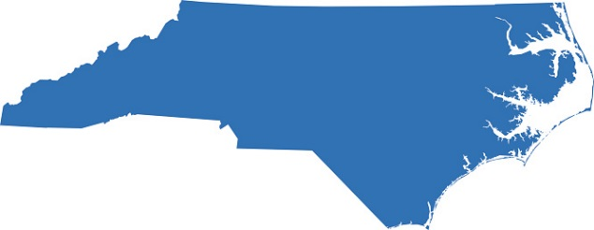

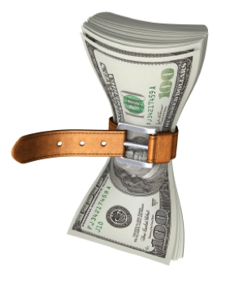

36
Independent companies covering 50 states
Fully Taxed Not For Profit
A 1933 Startup
Hospital Care Association
Notes:
Concern about the dire state of health care leads to the founding of the Hospital Care Association in Durham by George Watts Hill, prominent businessman, and Dr. W.C. Davison, dean of Duke University School of Medicine. The new organization, one of the parent organizations of today’s BCBSNC, offers prepaid hospital care to families for as little as 2 cents a day.
Thanks to the inclusion of maternity benefits, the nation’s first “Blue Cross baby,” Ann Woodard, is born in December at Durham’s Watts Hospital to parents enrolled in the new Hospital Care Association.
We support 3.9M customers in NC.
Employ 4700 NC people
106M members in BCBSA
BHI houses 10 years of history with over 180M members; largest healthcare analytic data store in the country
Paid $272M in taxes in 2015; put profits back into the community to improve healthcare.

Slide 5



IT is Different Here
Notes:
We are a tech company focused on data and analytics as a strategic capability.
A CEO that created Innovation in Medicare and Medicaid
A Chief Data and Analytics officer reporting directly to the CEO
Everything we do is about data, analytics, digital adoption
Super fun place to be right now if you want to be part of big change with big impact.
Announced just this week, we are super proud of this one. We are in the top 10 in benefits, so if you are nearing the end of your current gig, check us out!

Slide 6
Oh, The Places We’ll Go, Today!
Who
are we
What
are we doing
What
Is next
Why
are we changing
How
are things better
Questions?
you may have

Slide 7

Innovation?
Notes:
Innovation speaks of coming up with something new. But that all by itself has no impact. I like pictures and stories so let me tell you one to make my point.

Slide 8
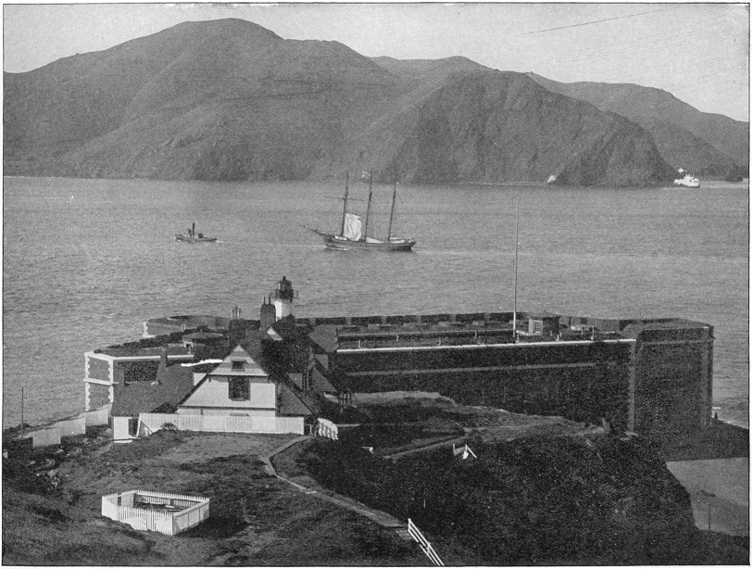
Notes:
First proposed in 1872 by a railroad executive named Charles Crocker.
First seriously considered in 1919, estimations put the cost at $100m
Too expensive
Would mar the scenery
Would interfere with navigating into the bay
Over 2000 lawsuits were brought, including one from the company owning majority stock in the ferry company who currently operated across the strait.

Slide 9
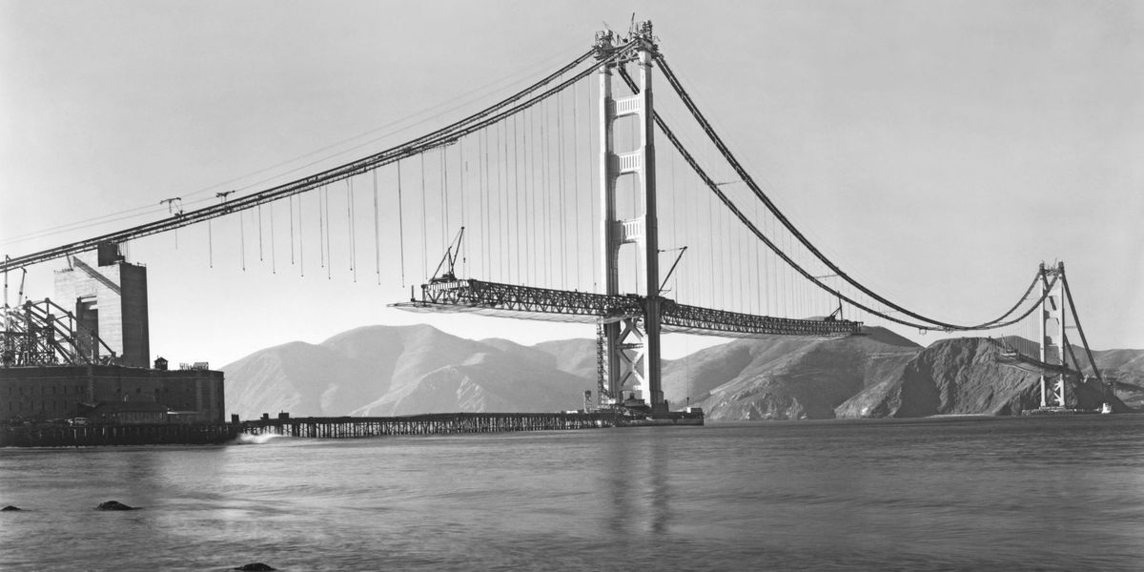
Transformation!
Notes:
Joseph Strauss – Draw bridge builder, said he could build it for a third of the lowest estimate to date.
Many safety inventions – Hard hats, the Halfway to Hell club… a net set to catch folks who fell from the bridge during construction saved 19 people who were known as members of the halfway to hell club. Only 1 death in 4 years against an average of 1 death per million dollars spent or 33 deaths. Just before the completion of the bridge a scaffolding fell tearing the net and 10 people died… raising the number of deaths to 11 for the project.
Most photographed bridge. ROI achieved well ahead of schedule. Built during the depression providing much needed jobs.

Slide 10
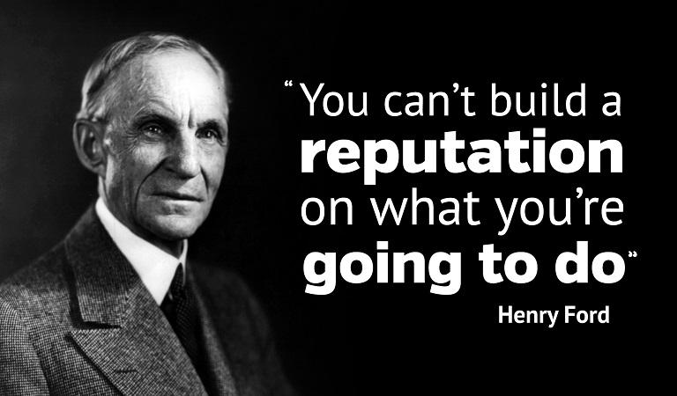
Notes:
Time to take some action, but what were the obstacles we had to work through, and what was the right work to do?

Slide 11
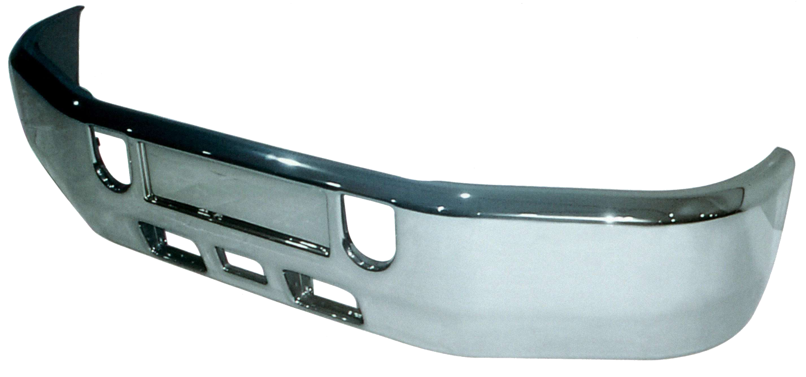
Notes:
If your job is building bumpers all day, and you go home knowing that this is what you do, how much passion do you have in your work? This is what we fall into when our work is specialized and we are separated from the impact. If you are in a supporting role you feel this. If you are in an impact role, this is good insight to consider.

Slide 12

Notes:
But once you see a car, then you understand how your work fits into something of value… something larger than your work. Now you get how you fit into the ‘machine’ and your passion is greater.

Slide 13
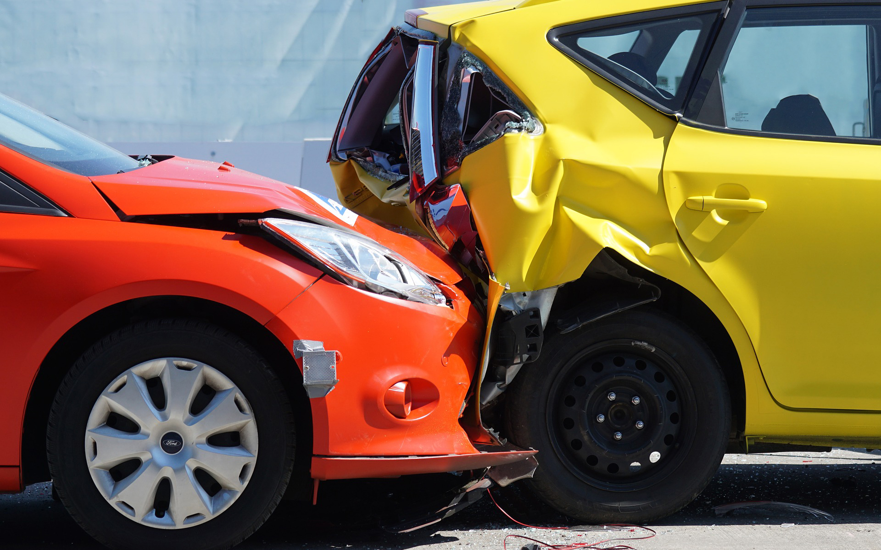
Notes:
But the real impact of what you do only comes when you come across this scene. Because now, you realize that the lives of others depends on that one piece of the machine that you are responsible for.
This was an insight we took into our work. We had to first move people away from their specialty role and connect to the impact we each have.
So what impact does data and analytics have in health insurance and health care?
How do we impact lives in NC?

Slide 14




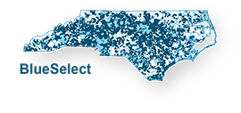



Avoid a Readmission
Med Savings from ML on Claims Review
New Lower Cost Products
Increase Quality
Value-Based Care
Reconcile ACA Cost Sharing Reductions
Notes:
You don’t have to look far. Here are just a few examples.

Slide 15
Oh, The Places We’ll Go, Today!
Who
are we
What
are we doing
What
Is next
Why
are we changing
How
are things better
Questions?
you may have
Notes:
So now we have the WHY figured out… we are connected to the value.
Where do we start?
What technical work do we do first?

Slide 16
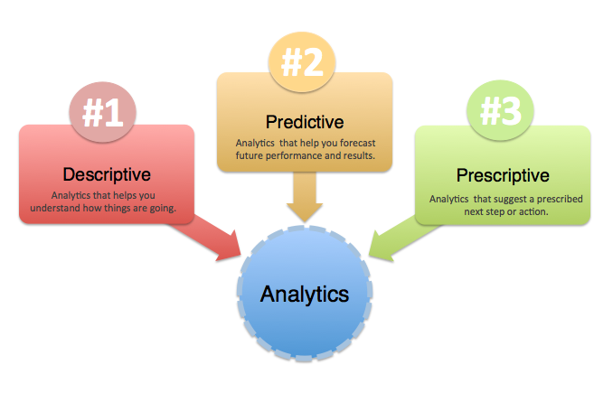
Types of Analysis
How many members are likely to get the flu this coming year?
How much will it impact our overall PMPM costs in February?
How many of our members had the flu last year?
What were the medical costs associated with the flu?
How would costs be effected if we provided free flu vaccines?
Who should we reach out to to prevent hospital admissions from the flu?
Notes:
We started by looking at the types of analytics we were good at, and the what we needed to be good at for the future.

Slide 17

Accelerating Analytic Discovery
DESCRIPTIVE
Fast First Access to data
Exponential increase in platform capacity
Modernize analytics toolset
Reduce IT Friction
AND
Drastically reduce cost
DIAGNOSTIC
Predictive
prescriptive
descriptive
Diagnostic
PREDICTIVE
PRESCRIPTIVE

Slide 18




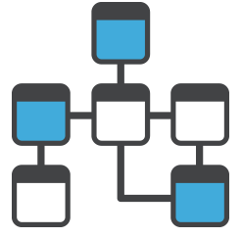








Traditional BI & Analytics on a Data Warehouse
Months…
Understand
Transform
New Data
First Access
Ingest
Structure
Test
Months…
Prioritization, Funding, Planning Process
Value

Slide 19
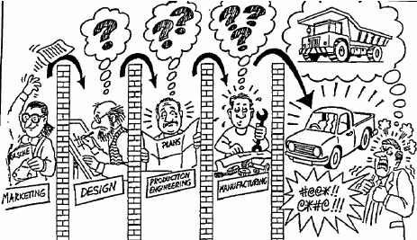

Slide 20
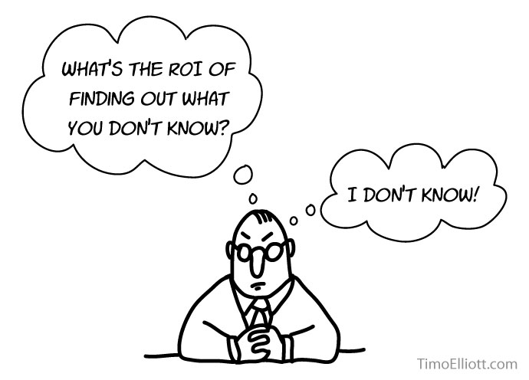

Slide 21


Transforming to a New Way of Working
Days…
Transform
New Data
Ingest
Structure
Test
Operationalize
Understand
First Access
PRESCRIPTIVE
PREDICTIVE
Value
Value

Slide 22
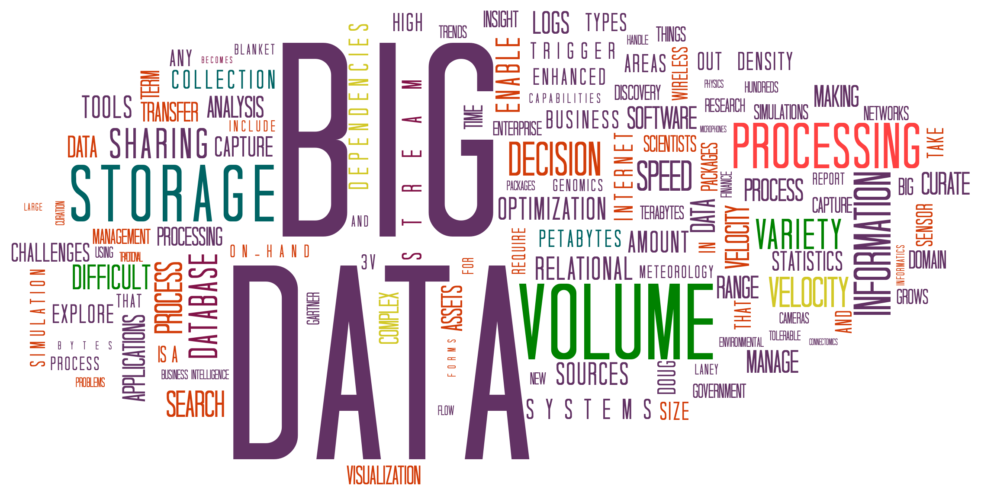
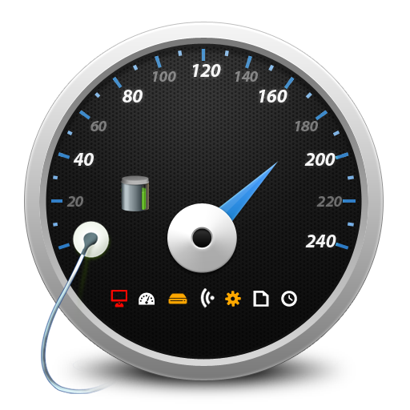
What to Do?
Fast First Access to data
Exponential increase in platform capacity
Modernize analytics toolset
Reduce IT Friction
AND
Drastically reduce cost
Removing Waste/Optimization

Slide 23
Oh, The Places We’ll Go, Today!
Who
are we
What
are we doing
What
Is next
Why
are we changing
How
are things better
Questions?
you may have

Slide 24











Quantitative Impacts

Fast First Access
< 1 week
Months

Platform Capacity
Accelerating Analytic Discovery
85
2
Terabytes for Analytic Discovery
Terabytes for Analytic Discovery

Modernize Toolset

Slide 25

Quantitative Impacts

Reduce IT Friction
To Days
Implementations from Months

Reduce Costs
Accelerating Analytic Discovery
Annual Data Platform Cost
$5 million
$3.1 million
Annual Cost/Terabyte
$41.6k
$14.7k
Analytics Toolset (annualized)
$908k
$5k

Slide 26
Removing Waste/Optimization

Slide 27

Removing Waste
Teradata Platform
Production Support
Information Architecture
35% to 75%
28%
Performance Improvement
Cost reduction through Common Form
90%
Facets Individual Migration
Blue Connect Optimization
IVR/TREX
Blue Connect Mobile
OMS
Pega Claims
Book of business
Commissions
BlueE
CCFE
CAFE
Less Message Abends
20
Terabytes Recovered
10
0
Hr Reduction in Batch
Support Ticket Backlog

Slide 28
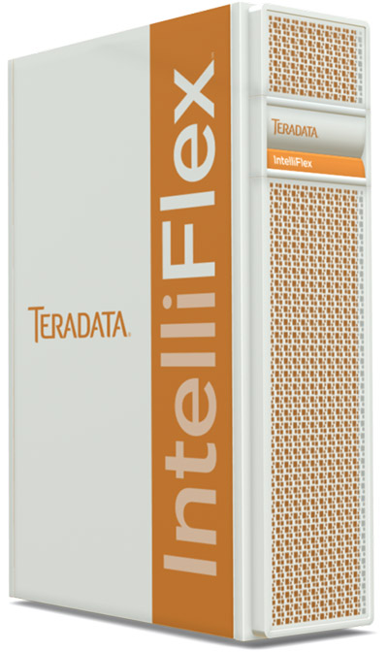
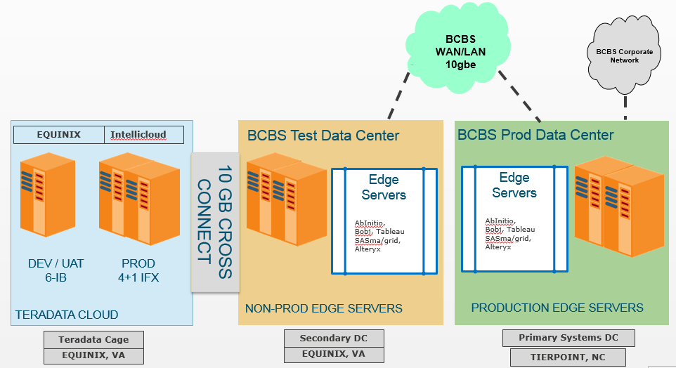

Teradata – A Move from On Premises
Reduced Annual Cost by 50%
Increased overall capacity by 42%
Added ~20% capacity on demand
Upgraded to new version and new technology

Slide 30

Notes:
Timing is everything
Perhaps the most important decision we made is to NOT go to Big Data. We made this decision about 3 times over two years. We were not ready, and delaying allowed us to stand on the shoulders of the early adopters to avoid mistakes.

Slide 31
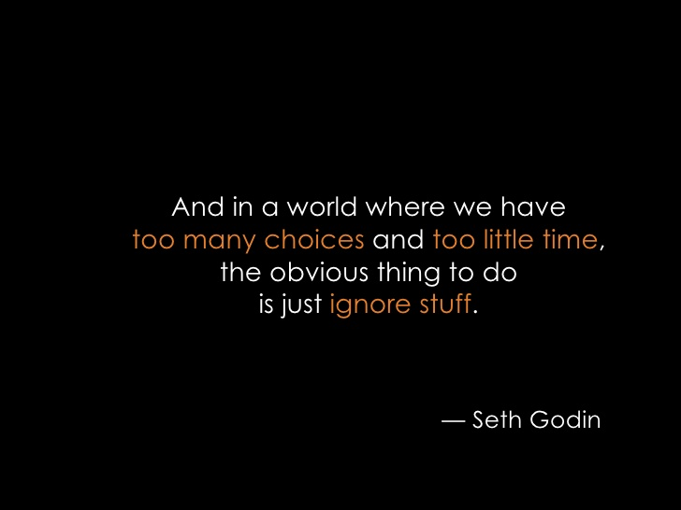
Notes:
Many implementations struggle through a process of defining all the possible use cases and involving lots of decision makers in the process. This is new technology. The more leaders you involve the more you have to educate to get to an informed decision. And the more options you present, the more paralyzed the decision making becomes.

Slide 32

Notes:
Tightly coupled or ‘sticky’ technology can make it difficult to pivot when newer tech comes along. If you build everything based on MapR and Spark comes along as a replacement? If you go with AWS and then want to switch to Azure. If you develop with a dependency on a proprietary feature like Impala?
Just have your eyes wide open when making decisions as most will be short-lived as technology changes. Investments in technology and in people who can adapt to changing tech are future proof. Everything else is suspect.

Slide 33
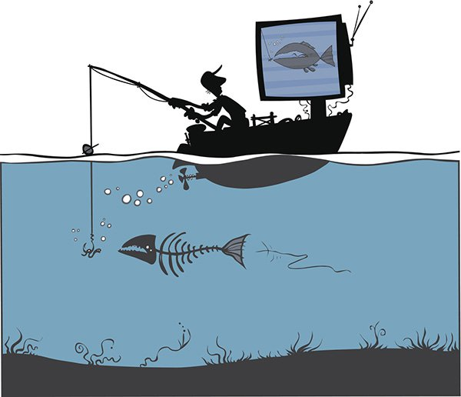
Notes:
Not providing proper administration or support for the data lake led to data swamps. Many implementations were done by a resource or two as an extension to their current full time job. As things grew, they did not have time to keep things up and over time the ingestion, quality, security, access, cataloging all got out of control.

Slide 34

Our Business Case

Slide 35






Selecting a distribution

Slide 36
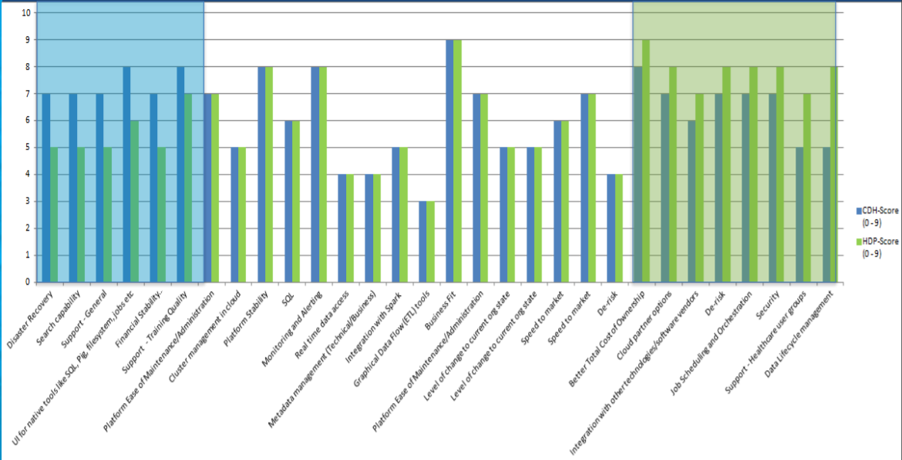
Selecting a distribution

Slide 37



Hadoop Implementation
3
10
Months to implement
Percent cost of Teradata
0
900
Increase in headcount
Thousand $$s cost avoidance
Accelerating Analytic Discovery
4
500
Active archives in 3 months
Hours of orientation sessions
After
Before
85
Analytics Discovery Capacity
2
terabytes
terabytes

Slide 38
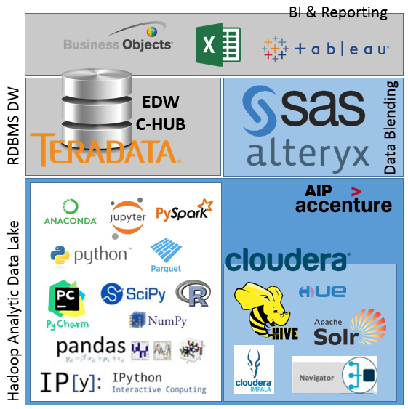
BCBSNC - Analytic Platform
Hadoop Analytic Data Lake
Fast First Access
Rapid Analytic Discovery
Low cost compute and storage
Variety of Open Source discovery tools
RDBMS Data Warehouse
Enterprise source for core data
High performance with high concurrency
Production process for scheduled loading
Relational data model to support adhoc needs
Data Blending
Data preparation for data engineers
Used for BI and Reporting data prep
Allow some scheduling and repeatability
BI and Reporting
Descriptive and Diagnostic reports
Leveraged by a large number of more casual information consumers
Provides some interaction with information

Slide 39
Analytics on Hadoop – Predicting Hospital Readmissions
“Can the combination of unstructured text from nurses’ notes and structured data such as the BCBSNC claims dataset be used to predict the likelihood for readmission within 30 days?”
100
8
Funded by IT
Structured and Unstructured Data Sources
Total cost $168k
$760k/yr in Identified cost reduction
Handed off to Enterprise Analytics
Percent Open Source tools
Weeks, start to finish
85
4:1
Percent Accuracy
ROI on Engagement

Slide 40

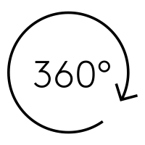


Measurable Improvements
Ops Analytics
Impact from new resource
6 weeks
3 days
Data for Model development
Sample
Full
Time to insight
6 weeks
1 week
Impossible to DONE in 3 days!
6 Terabytes of ‘unplanned’ space
Billions of computations on full volume data
Enterprise Analytics Analyst had limited experience with Hadoop
Benchmarks led to insights being added to Medical Expense and Total Market Price Dashboards
ON

Slide 41
Oh, The Places We’ll Go, Today!
Who
are we
What
are we doing
What
Is next
Why
are we changing
How
are things better
Questions?
you may have

Slide 42







A Word on Collaboration
Data & Analytics Leadership
Evening of
OMNICHANNEL
Leadership

Slide 43
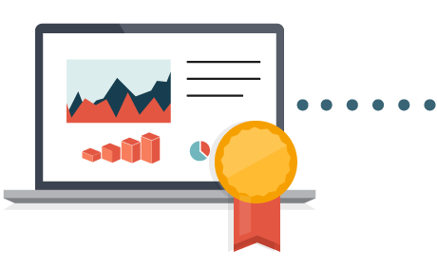








What’s Next?
Obsession with Data Quality & Governance
Dramatically reduce cost and time of Information Delivery
Align to industry standards to reduce friction leveraging strategic partners
Radical focus on business outcomes
Embrace new technologies and methods

Slide 44
Oh, The Places We’ll Go, Today!
Who
are we
What
are we doing
What
Is next
Why
are we changing
How
are things better
Questions?
you may have

